Slide 1
Cardinality Estimation
Presented By:
George Wu
Georgewu.wu@mail.utoronto.ca

Slide 2
Definition
What is Cardinality Estimation?
Ability to estimate how many rows a query will yield
Why is it important?
Helpful for estimating queries with a specific plan cost
Buffering for an execution phase (e.g. Joins)

Slide 3
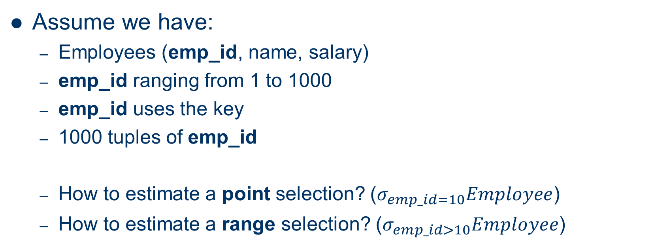
Examples of Cardinality Estimation
Assume we have:
Employees (emp_id, name, salary)
emp_id ranging from 1 to 1000
emp_id uses the key
1000 tuples of emp_id
How to estimate a point selection? ($σ_{emp_id=10}Employee$)
How to estimate a range selection? ($σ_{emp_id>10}Employee$)

Slide 4
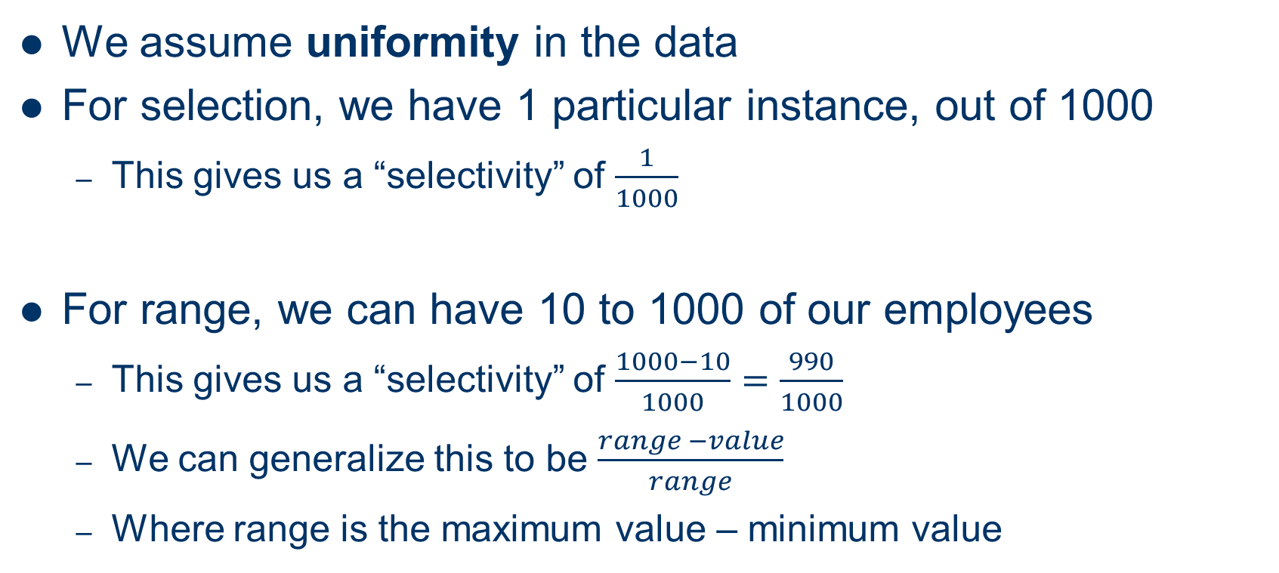
Naïve approach
We assume uniformity in the data
For selection, we have 1 particular instance, out of 1000
This gives us a “selectivity” of $\frac{1}{1000}$
For range, we can have 10 to 1000 of our employees
This gives us a “selectivity” of $\frac{1000−10}{1000}=\frac{990}{1000}$
We can generalize this to be $\frac{range −value}{range}$
Where range is the maximum value – minimum value

Slide 5
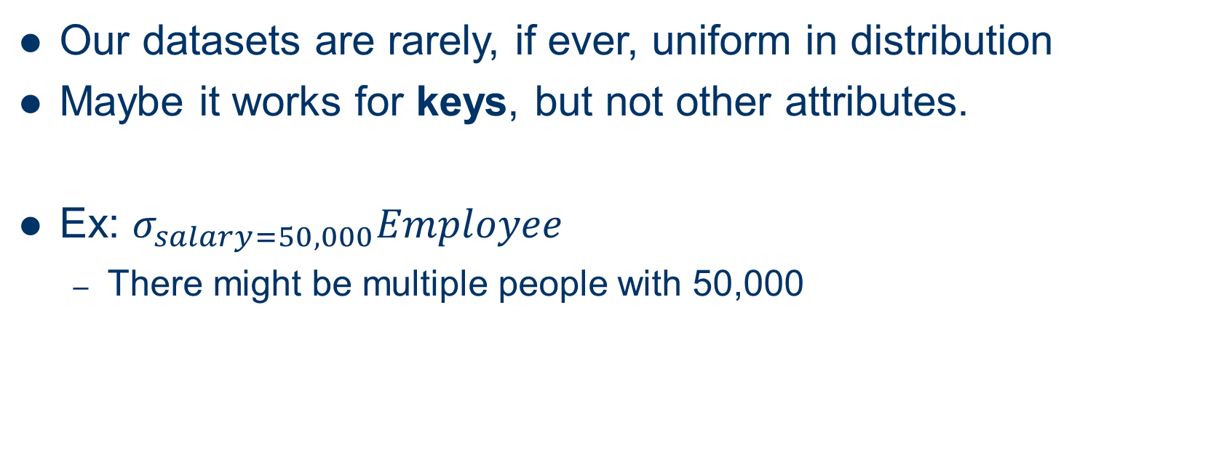
Problems?
Our datasets are rarely, if ever, uniform in distribution
Maybe it works for keys, but not other attributes.
Ex: $σ_{salary=50,000}Employee$
There might be multiple people with 50,000

Slide 6
What are the current solutions to this?
There are two main solutions:
Histograms
Find a statistical estimation of the dataset at hand
Random sampling
Take a small sample size of your dataset, run the query, then extrapolate the results

Slide 7
What are the current solutions to this?
There are two main solutions:
Histograms
Find a statistical estimation of the dataset at hand
Random sampling
Take a small sample size of your dataset, run the query, then extrapolate the results
Notes:
We focus on histograms for our introduction

Slide 8
Motivation
So why histograms?
Again, size estimates are needed for costs of access plans
What are some features we should expect?
Should produce estimates with small errors
Inexpensive to build, use and maintain
Notes:
Size estimates are needed for costs of access plans. It can be disastrous to our query optimizer if we guess the wrong cardinality, since we will pick a bad plan!

Slide 9
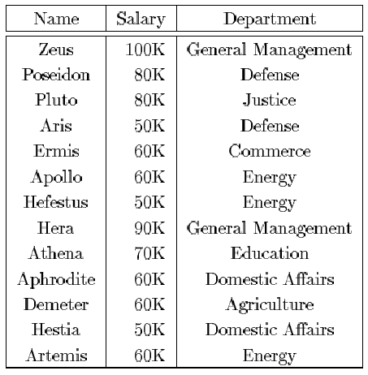
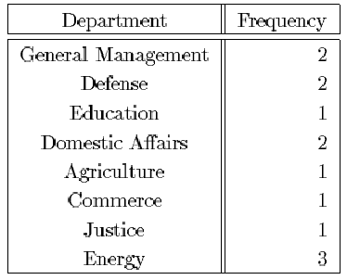
Data Distribution
Histograms are approximations of data distribution
Data distribution is a set of (attribute value, frequency) pairs
Notes:
We can see how we build a histogram from the Employee table to a (Department, frequency) pair

Slide 10
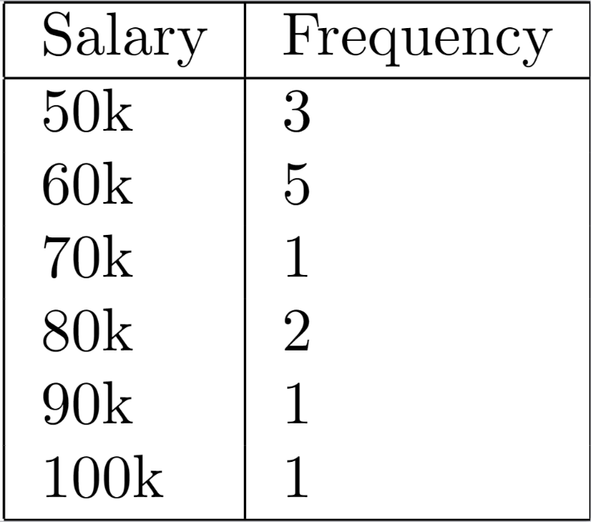
Data Distribution – More examples
How would a salary distribution graph look like?
Notes:
Again, we have an (attribute, frequency) pair in order to write our histogram

Slide 11
Data Distribution
Set of (attribute value, frequency) pairs
If we had this data distribution, we could easily answer any single dimension query.
Selection (range, point), join
But this is very bulky!

Slide 12
Problems
What if salary wasn’t just multiples of 10000?
Ex: 10,001, 25,500, 101,000
To have one frequency per individual value, we run out of memory really quickly!
So, we choose to group them into buckets, and use histograms

Slide 13
From Data Distribution to Histogram
Freq
Value
Notes:
We take the frequency vs. value distribution, and group them into buckets.

Slide 14
From Data Distribution to Histogram
Freq
bucket 1
bucket 2
Value
Notes:
Here, we assume that within the bucket, we have uniformity. Note that this still has the same “total” value.

Slide 15
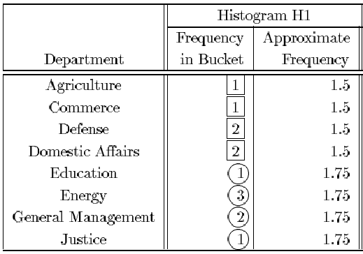

Slide 16
Histograms
Equi-width histograms
This is a histogram where the spread of each bucket is the same
Spread S and Area A
S_{i} = V_{i+1} – V_{i}
A_{i} = f_{i} * S_{i}
where V_{i} is an attribute value f_{i} is its frequency
Notes:
The spread is the distance from one attribute value to the next.
Area is the frequency times the spread.

Slide 17
Spread S and Area A
Freq
Area
Spread
Value

Slide 18
Equi-width histograms
We divide the value axis into buckets of equal ‘width’ (spread equalized)
Advantages
Natural order of the attribute-values is preserved
Ex: Tuples x<5 can be easily answered by going from the bucket containing 5 to the beginning
Disadvantages:
We assume uniformity within each bucket
High variance. (within one bucket, we could have a high frequency for one value, and low frequency for another value)

Slide 19
Equi-depth
Perhaps instead of equalizing on range of values, we equalize on number of tuples within a bucket
However, the disadvantages may still be here:
Variance are still very high
More complex to maintain
Works well for range queries when the data distribution has low skew

Slide 20
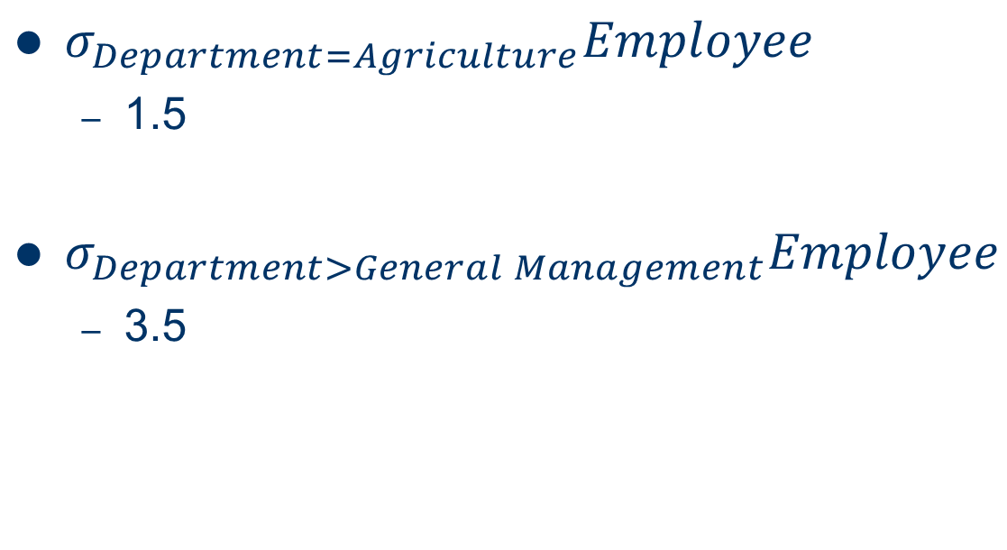
Example of estimation
$σ_{Department=Agriculture}Employee$
1.5
$σ_{Department>General Management}Employee$
3.5

Slide 21
Alternative histograms
Equi-width
Sum of spreads (max val – min val) are approximately equal
Equi-depth
Sum of frequencies are equal
V-Optimal
Group sets of frequencies into buckets, and keep the sum of frequencies approximately equal.
Usually the best
Notes:
There are many types of histograms out there. Depending on what you want to do, they offer different advantages.

Slide 22
Bottom Line for Histograms
As we can see from our examples, these histograms have been relatively well used
Classically, they are still in use today
Very efficient for estimating cardinality for one-dimensional joins

Slide 23
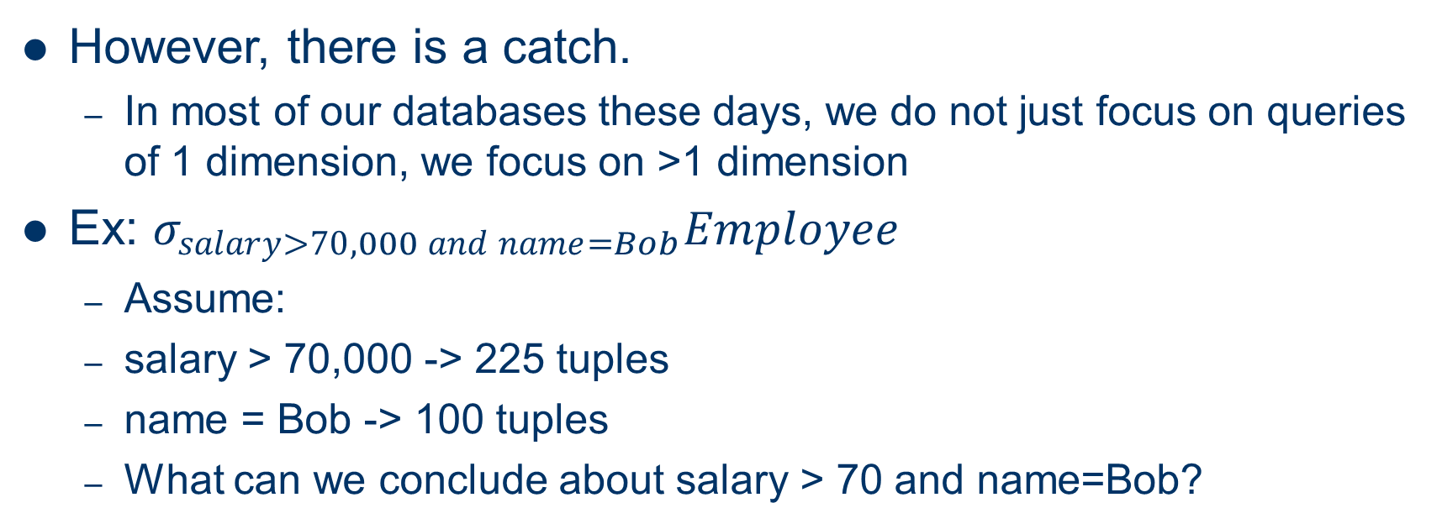
Scaling to Higher dimensions
However, there is a catch.
In most of our databases these days, we do not just focus on queries of 1 dimension, we focus on >1 dimension
Ex: $σ_{salary>70,000 and name=Bob}Employee$
Assume:
salary > 70,000 -> 225 tuples
name = Bob -> 100 tuples
What can we conclude about salary > 70 and name=Bob?

Slide 24
Problems
From these two sets, the two individual histograms tell us nothing about which ones belong to both!
We cannot conclude that every person with salary > 70,000 is Bob!
We do not know how many Bob’s have salary > 70,000
In fact, we can only assume there can only be between 0 and 100 of qualifying tuples.

Slide 25
Extending to multi-dimensional Histograms
One way to tackle this problem is to use multi-dimensional histograms
Instead of taking a bucket on one value, we can look at a two-dimensional bucket over a graph.

Slide 26
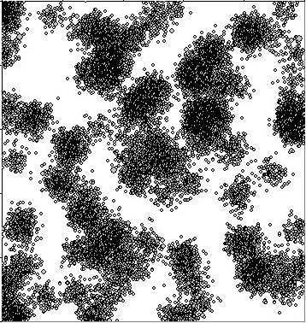
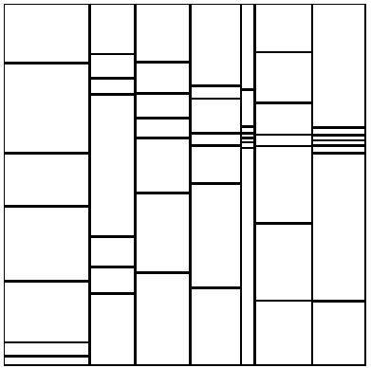
Example
Gaussian Data Set
EquiDepth Histogram
[Muralikrishna and DeWitt 1988]

Slide 27
EquiDepth 2-D histogram
Similar to Equip-depth 1D histogram
Each bucket contains approximately the same number of tuples.
However, other types of 2D histograms also exist, but beyond the scope for now

Slide 28
Problems
While 2D histograms may work decently for queries over 2 attributes, can this really be scaled towards queries of over more and more attributes?
The space for something of N-D space would be huge, and not to mention sparse.
Thus, we choose another approach, autoencoders

Slide 29
Parts of an Autoencoder
There are two parts
Encoder ( h = f(x) ), which takes an input and compresses it down
Decoder ( r = g(h) ), which takes a compressed version and tries to reconstruct.
Usually has a bottleneck.
Train using a loss function

Slide 30
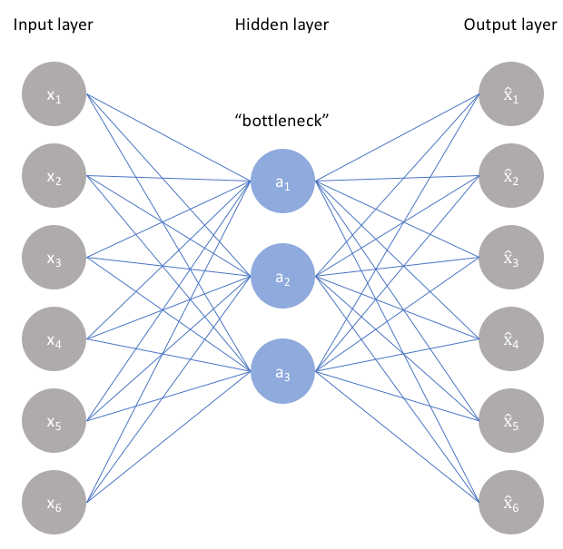
Example
Image from https://www.jeremyjordan.me/autoencoders/

Slide 31
Why use a bottleneck?
The bottleneck is important here
Formally, the hidden layer should be in a smaller dimension than x.
If the dimension of h == dimension of input, then the network could simply learn to memorize the input values.
The f(x) can simply just be the identity function
Reconstruction can also be the identity function.

Slide 32
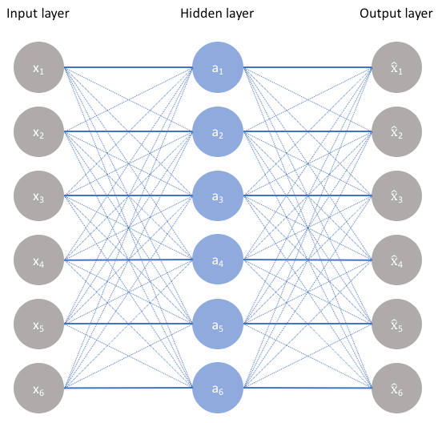
Example
Image from https://www.jeremyjordan.me/autoencoders/
Notes:
In this case, the model could simply take whatever the input is, use it as it’s hidden layer, and then move it to the output layer.
The bolded lines indicate the way the information can be passed

Slide 33
Bottleneck
Constrains the amount of information that flows through the neural network.
Forces the model to learn a compressed version of the input data.
Thus, it can learn the underlying “structure”

Slide 34
Types of Bottlenecks
We can use a lower dimension for h.
Known as a undercomplete autoencoder
Can also use a denoising autoencoder
Idea is to have the model learn a “good enough” representation such that any noise introduced will have no effect
Done by introducing noise to your input, x, say with noise(x), and then comparing the prediction of noise(x) to x

Slide 35
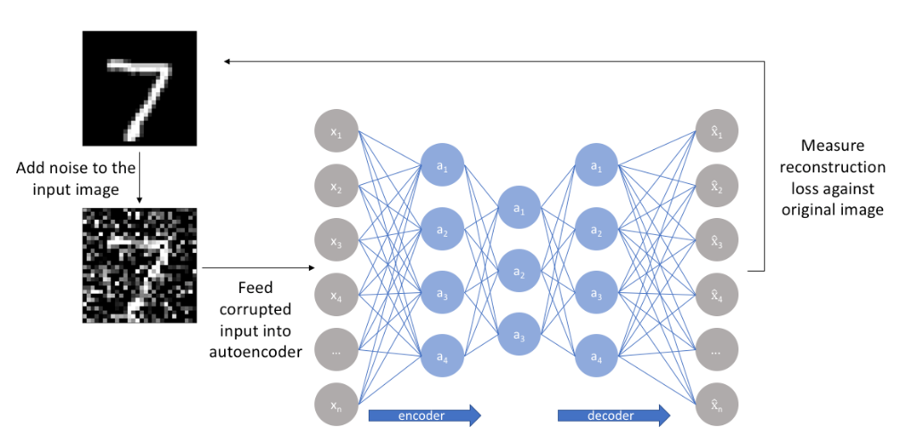
Example
Notes:
The original image, is corrupted with noise. From there, the noise is fed into the network, and the reconstruction is compared against the original image.

Slide 36

Loss Function
Train using cross entropy loss function

Slide 37
Problems with autoencoders
We cannot get a probability estimation of the distribution of data.
Instead, only a reconstruction or “prediction” of the sample data.
Note that if we could get a probability distribution, we can easily model any dataset with an autoencoder.

Slide 38
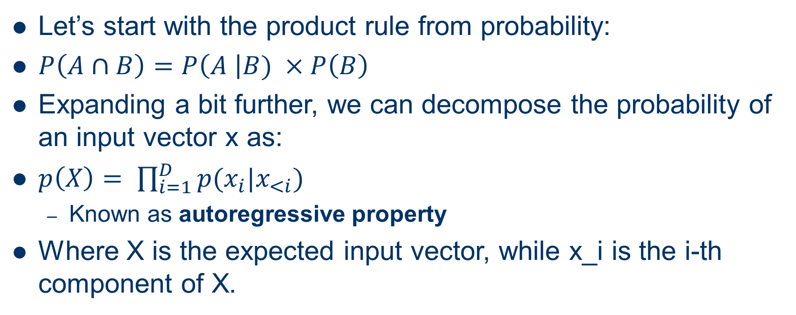
Modifying Autoencoders
Let’s start with the product rule from probability:
$P\left(A∩B\right)=P\left(A \right|B) ×P\left(B\right)$
Expanding a bit further, we can decompose the probability of an input vector x as:
$p\left(X\right)= \prod_{i=1}^{D}{p(x_{i}|x_{<i})}$
Known as autoregressive property
Where X is the expected input vector, while x_i is the i-th component of X.

Slide 39
Modifying Autoencoders
In a fully connected autoencoder, the inputs to each layer relies on every input of the previous layer IE, x_i depends on 1 - D
The Product rule tells us that the probability of any specific x_i depends on j < i.
What if we could make the probability distribution created in an autoencoder reflect the autoregressive property by introducing masks.

Slide 40
Example
Image from https://www.jeremyjordan.me/autoencoders/
Notes:
In this case, the model could simply take whatever the input is, use it as it’s hidden layer, and then move it to the output layer.
The bolded lines indicate the way the information can be passed

Slide 41
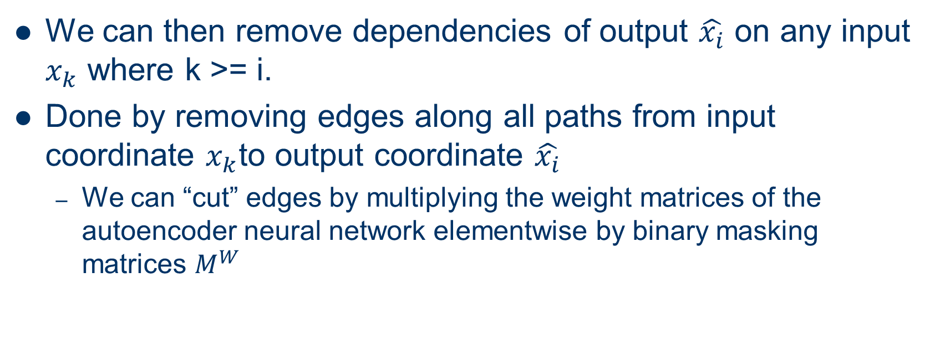
Modifying Autoencoders
We can then remove dependencies of output $\hat{x_{i}}$ on any input $x_{k}$ where k >= i.
Done by removing edges along all paths from input coordinate $x_{k}$to output coordinate $\hat{x_{i}}$
We can “cut” edges by multiplying the weight matrices of the autoencoder neural network elementwise by binary masking matrices $M^{W}$

Slide 42



MADE
For input:
$m^{l}(k)$ is index assigned to hidden node k in layer l
For output:

Slide 43
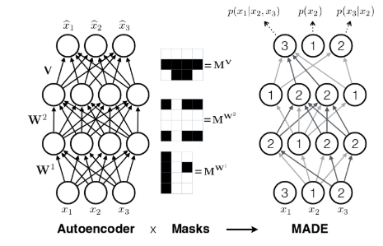
Example

Slide 44
MADE
This creation of an autoencoder allows us to estimate a valid probability distribution
Can even be used to train multiple models, regardless of ordering
A “forest” of models, to help us predict a probability distribution

Slide 45
Multi-attribute Selectivity Estimation
So how can we gain high accuracy through a lightweight model for our dataset?
Multidimensional histograms are space prohibitive
Simplifying assumptions on the data (value independence) is not accurate.
Idea: Use deep learning to learn the underlying distribution, then use them to predict
Notes:
We return to the problem of multi-attr selectivity. We want something with high accuracy, while having low space constraints.
One obvious choice is to use deep learning models to attempt to learn the data.

Slide 46
Two Approaches
One is unsupervised learning
We can use MADE in order to learn the data function
Other is supervised learning
Use a neural network in order to learn the data function from training data.

Slide 47
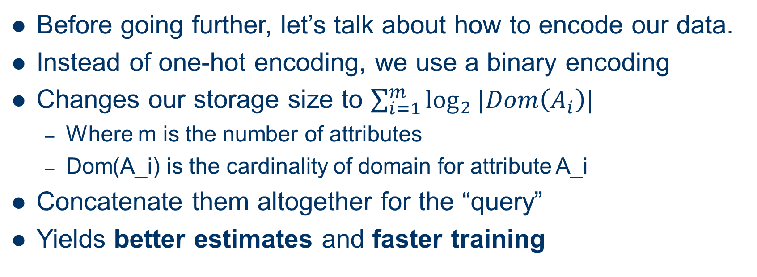
Encodings
Before going further, let’s talk about how to encode our data.
Instead of one-hot encoding, we use a binary encoding
Changes our storage size to $\sum_{i=1}^{m}{\log_{2}{|Dom\left(A_{i}\right)|}}$
Where m is the number of attributes
Dom(A_i) is the cardinality of domain for attribute A_i
Concatenate them altogether for the “query”
Yields better estimates and faster training
Notes:
When concatenating, consider something like:
01 10 01 11
Means A1 = value 1, A2 = value 2, A3 = value 1, A4 = value 3

Slide 48
Example
Let Dom(A_j) = [0,1,2,3]
One hot encoding:
1000, 0100, 0010, 0001
Binary encoding:
00, 01, 10, 11
Notes:
Go through the one-hot encoding vs binary encoding example here.
0000 is for 0, 0100 is for 1, etc.
00 is for 0, 01 is for 1, etc.

Slide 49
Point and Range Queries
We can now use MADE in order to estimate the probabilities
When having A_{i} = a_{i} , encode into a query, and feed into model.
Range queries are harder though.
Note that a range is lb_{i} <= A_{i} <= ub_{i} (A_{i} ranges from lower bound to upper)
A point query is equivalent to a_{i} <= A_{i} <= a_{i} (A_{i} ranges from a_{i} to a_{i})
If unspecified, then say min(A_{i}) <= A_{i} <= max(A_{i}) (Ai can take all values over its domain)
Notes:
Here are the various ways to understand the range query possibilities.

Slide 50
Range Queries
Can do exhaustive enumeration
For each possible point query in range, evaluate them
Can do uniform sampling
For each range, uniformly sample, getting values for each range
Estimate selectivity for one value
Repeat and normalize

Slide 51
Adaptive Importance Sampling
Uniform has its problems, since the dimensions may grow large
Attributes that should appear more, should be weighed more
Start with uniform sampling
With future stages, generate samples using histograms with a distribution estimate
Ex: query x₁ = a₁, x₂ =a₂, x₃ = a₃ will be selected based on the histogram estimation of a₁
If a₁ occurs more often, this will be reflected in the histogram

Slide 52
Further optimizations
We can choose different attribute orders
Permuting multiple models can be helpful for average case
We do not have to “retrain” a new model on new data, just initialize a new model with the same weights as before and update from there (incremental learning)
Avoid “catastrophic forgetting”
Notes:
We can optimize different attribute orderings. If we know that there is a preferred ordering IE employee ID is related to date of joining, this could be easy to learn.
Could also do multiple permutations of attribute orders in order to create multiple models. This helps to avoid one “bad ordering” and to have an average prediction that is agreed on by multiple models.
Catastrophic forgetting is where the model forgets the old data and focuses exclusively on new data.

Slide 53
Supervised Learning
Want to build a model that accepts an arbitrary query as input and output selectivity
Model can learn appropriate weights for features, then use those features to estimate
Weights can be learned from past queries and true selectivity

Slide 54
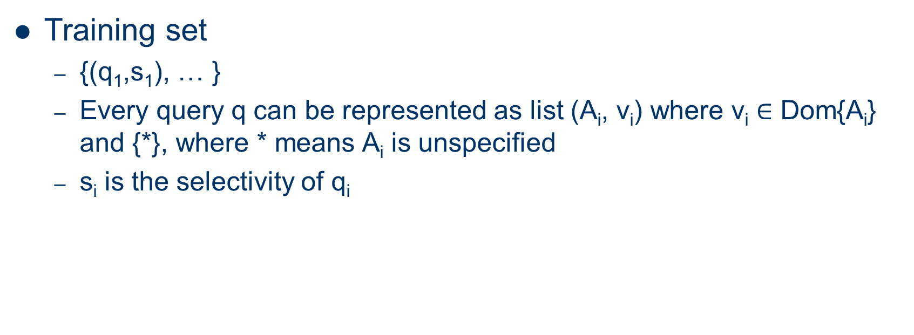
Encoding … Again
Training set
{(q₁,s₁), … }
Every query q can be represented as list (A_{i}, v_{i}) where v_{i} $∈$ Dom{A_{i}} and {*}, where * means A_{i} is unspecified
s_{i} is the selectivity of q_{i}

Slide 55
Example
({A1 = 0, A2 = 1}, 0.3)
Means A1 = 0 AND A2 = 1, and this query has a selectivity of 0.3
({A1 = *, A2 = 1}, 0.1)
Means A1 = anything AND A2 = 1 has a selectivity of 0.2

Slide 56
Encoding Queries
For query values, we have one-hot encoding of length |Dom(A_{i})| + 1
Given m attributes, we simply concatenate all m of them in a row for our one-hot encoding vector

Slide 57
Example
Dom(A₁) = [1,2,3,4]
Dom(A₂) = [1,2,3]
Query is A₁ = 1 AND A₂ = 3
One hot encoding would be:
100000010
Red is A₁
Blue is A₂
Notes:
Notice the one-hot encoding has 5 for A1 because it is length 4 + 1, and A2 is 3 + 1

Slide 58
Encoding Selectivity
We can encode selectivity by doing an absolute log value, then normalize back to [0,1] range
Example:
Selectivity is [0.1, 0.01, 0.002]
Apply log transformation to get [1,2,3]
Applying normalization (value – minimum) / (maximum – minimum)
[0.0, 0.5, 1.0]
Notes:
Get the normalization formula into the slide I suppose
Talk about how 0.0, 0.5, 1.0 comes up.

Slide 59
Training and Inference
Train on min Q-error
<Insert equation here>
When given a new query:
Convert to one-hot encoding, feed it to the model
Apply reverse transformations
Get output that represents actual selectivity

Slide 60
Generating Training Data
With no queries available:
Choose number of predicates k, from 2 to m, where m is the number of attributes
Then choose k attributes uniformly at random from set of attributes
Choose random tuple t from the relationship
Create a query where the k attributes chosen are the same as the tuple chosen.
Notes:
Example: Take an employee with salary 100,000, George, and empid of 3. If you chose salary and empid, your query would be salary = 100, 000, empid = 3

Slide 61
Generating Training Data
When a query workload is available
We want to augment
Idea is that we sample more of the “popular” queries
IE if A1 was chosen 100 times, and A2 was chosen 50 times in the query set, we want to select them more
Then, we tell the model that accuracy for the original query workload should be high as possible.
Notes:
Query workload available section.

Slide 62
Encoding Range Queries
Note that a range query is easy to encode.
We just use the one-hot encode the specified range.
Ex: A₁ = [1,2,3,4,5]
2 <= A₁ <= 5 becomes
011110

Slide 63
Other Considerations
As incremental data comes in, just retrain on the dataset with updated selectivities
Again, try to avoid forgetting

Slide 64
Results
Conducted on both IMDB and Census
Using q-error, unsupervised and supervised are vastly accurate.
Linear regression and support vector regression are baseline worse.
Wavelets and histograms provide performance comparable, but allocated more resources
Bayesian nets are similar in final output, but still both supervised and unsupervised are superior in time and accuracy.

Slide 65
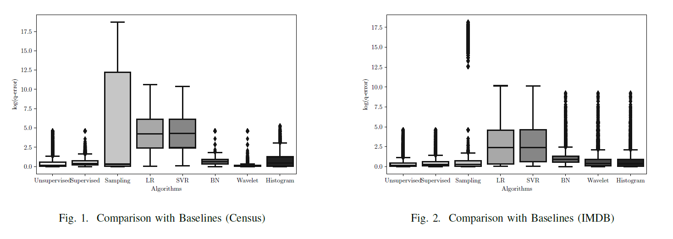

Slide 66
Results
Training was faster than Bayesian nets
1 minute on Census vs 16 minutes for BN on census
12 minutes vs 516 minutes for IMDB
We next consider 4 areas of performance
# predicates in query
Varying query selectivity
Attribute Correlation
Range queries

Slide 67
Results
# of predicates in query:
Good for low number of predicates
Still relatively close in accuracy as number of predicates increase beyond 7
Query selectivity
When selectivities are low or very low, method is able to provide excellent estimates that are off by a factor of at most 2

Slide 68
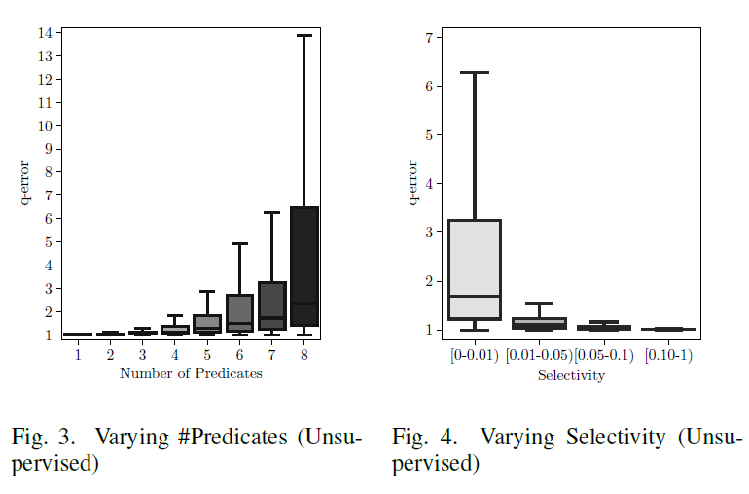

Slide 69
Results
Attribute Correlation
Small entropy means a lot of correlation
Models were able to learn
Range queries
Very close to actual selectivity

Slide 70
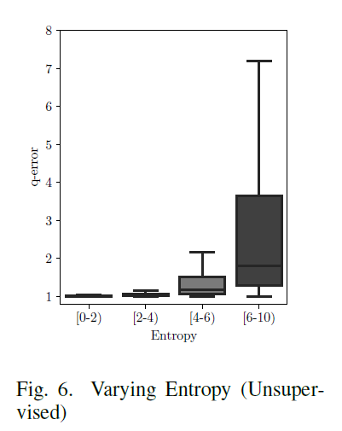
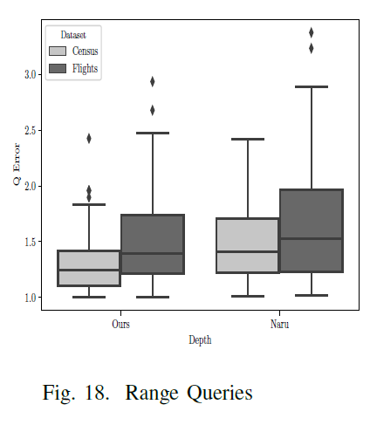

Slide 71
Estimating Join Cardinality
Now, we move onto the problem of estimating join cardinalities
Consider:
SELECT attribute list
FROM relation list
WHERE term1 and …and term k

Slide 72
Join Cardinality
Max # of tuples is product of the cardinalities of relations in the FROM clause
|R1| * |R2| * …
The reduction factor(RF) associated with each term reflects impact of the term in reducing result size
Result cardinality = Max # tuples * product of all RF

Slide 73
Uniformity
Assuming uniformity
Term col = val with index
RF = 1/Nkeys(I)
Term col1 = col2
RF = 1/MAX(Nkeys(I1), Nkeys(I2))
Term col>value
RF = (High(I) – value) / (High(I) – Low(I))
If missing indexes, assume 1/10

Slide 74
Problems
As discussed before, the real world rarely ever has uniformly distributed data
Furthermore the 1/10 is an arbitrary choice. Without any information, we choose to guess
Histograms can help here to give us information, but suffer from disadvantages discussed above

Slide 75
Learned Cardinalities and Correlated Joins
The subject of the final paper is to learn these cardinalities for joins
Consider the query:
SELECT * from emp, sal
WHERE emp.position = ‘Manager 1’
AND sal.salary > 100,000
Current techniques would estimate to be: 1/MAX( card(emp.position = Manager 1’), card(sal.salary > 100,000) )
Assumed to be independent
Notes:
This is a correlated join. Most managers that are above manager 1 are usually going to get a salary above 100,000.
The join is CORRELATED, which means our estimation based on uniformity breaks

Slide 76
Learned Cardinalities
Use supervised learning to learn from a query set
Use that query set in order to predict join cardinalities

Slide 77
Encodings … Again
They consider every query q to be a set of Tables, Joins, and Predicates
A table is a one-hot vector
Joins is also a one-hot vector
Predicates are of the form (col, op, val)
Col and op is a one hot encoding, with val is between 0 and 1, normalized using the min and max values of the respective column

Slide 78
Architecture
There are multiple sets (table, join, predicate) for each query.
We learn a set-specific, per-element neural network
Final representation for set is then given by the average
Then, we feed everything into one main cardinality prediction
Essentially, learn the cardinalities based on queries performed to then be able to predict the queries

Slide 79
Training Data
Used a query generator
Uniformly draws number of joins between 0 and 2
Then uniformly selects a new table that can join with current set of tables
Then uniformly draws the number of predicates
For each predicate, uniformly draw the predicate type (=, <, or >)
Select a literal from the corresponding column

Slide 80
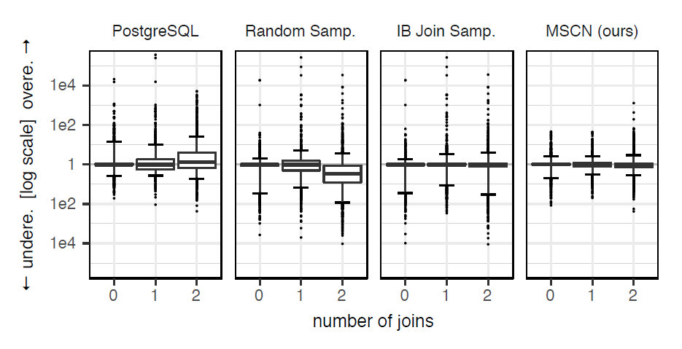
Results
Out-performed both POSTGres and Random sampling
Index-based join Sampling performed similar to this way, but uses more space

Slide 81
Conclusion
Deep learning can estimate cardinalities well
Beats out current ideas
But is it robust enough?

Slide 82
References
https://www.jeremyjordan.me/autoencoders/
http://bjlkeng.github.io/posts/autoregressive-autoencoders/
http://www.deeplearningbook.org/contents/autoencoders.html

